Slide 1
HOW AUGMENTED REALITY
IS TRANSFORMING
FIELD SERVICE MANAGEMENT

Slide 2
Challenges in Field Service Management
Inadequate skills training Little or no formal training.
High technician turnover Aging workforce and fewer people entering trade.
Inconsistent service delivery Many technicians are contracted through a third parties.
Reliance on short-term labor Little or no adherence to appropriate standards and practices.
Notes:
Best-in-Class organizations are embracing emerging technologies like Augmented Reality (AR) to help manage these new workforce pressures.

Slide 3
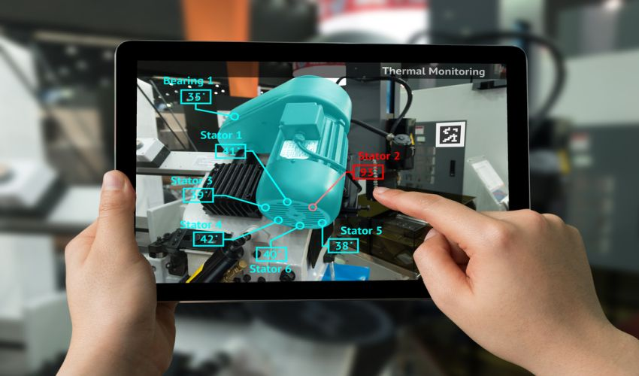
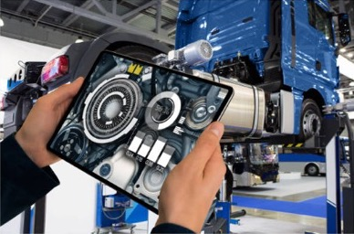
Augmented Reality Defined
Overlays digital information including schematics, instructions, annotations, and performance and condition status on physical assets.
AR can be experienced on Smart Phones & Tablets to wearable headsets like the Microsoft HoloLens.

Slide 4
Augmented Reality Benefits
Highly effective & immersive training
Engaging Sales & Marketing
Cost effective & Immersive Product Design - IoT and Digital Twin
Efficient & effective Field Service
Notes:
No Longer seen as marketing “gimmick” > Has evolved to show measurable impact through the entire product lifecycle and customer experience.

Slide 5
Augmented Reality for Field Service
Training
Field Guides
Expert Assistance
Faster knowledge transfer
Just-in-time
Access to subject matter expertise
Increase know-how
Faster time to resolution
Take the equipment to the expert instead of taking the expert to the equipment
Improves retention rates
Reduce errors
Efficient
Operational consistency
Information accessibility
Improve quality
Performance excellence
Improve outcomes
Enable process optimization

Slide 6
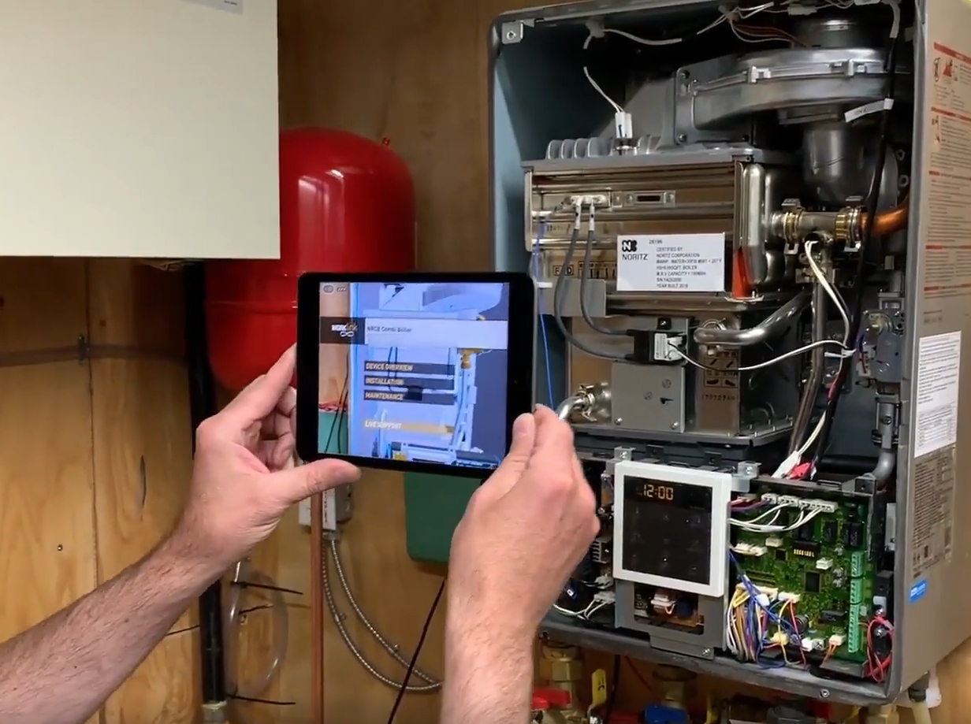
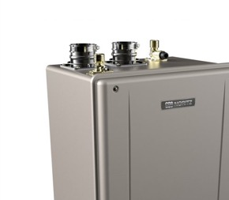
Field Service Use Case: Combi Boiler Installation and Maintenance
Installations (USA) 1,000s
Field Technicians 3rd Party
Experts None
Client
NORITZ (Residential)
Challenge
NRCB Combi Boiler installed and maintained by 3rd party; quality of service not regulated
Solution
3rd party servicing using AR visual instructions + remote expert access; service completion checklists and insights.

Slide 7
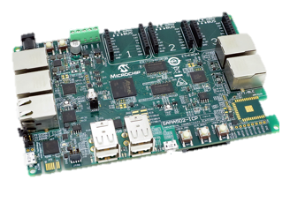
Field Service Use Case: Mitsubishi MPIO Board Repair
Installations (USA) +200
Field Technicians 30
Experts 8
Client
Mitsubishi
Challenge
Industrial equipment power supply control board, replacement labor was expensive
Solution
Client servicing using AR visual instructions + remote expert

Slide 8
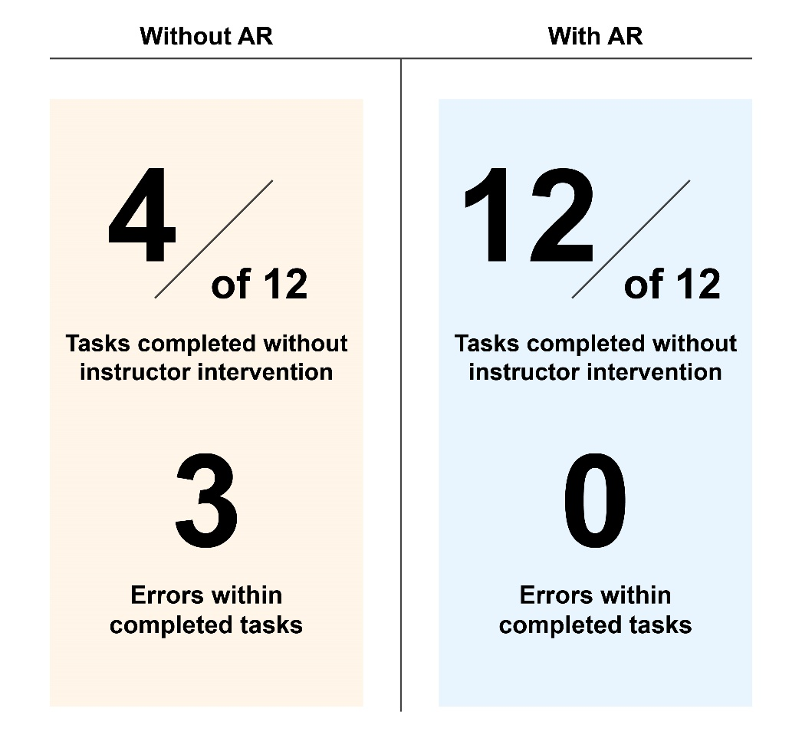
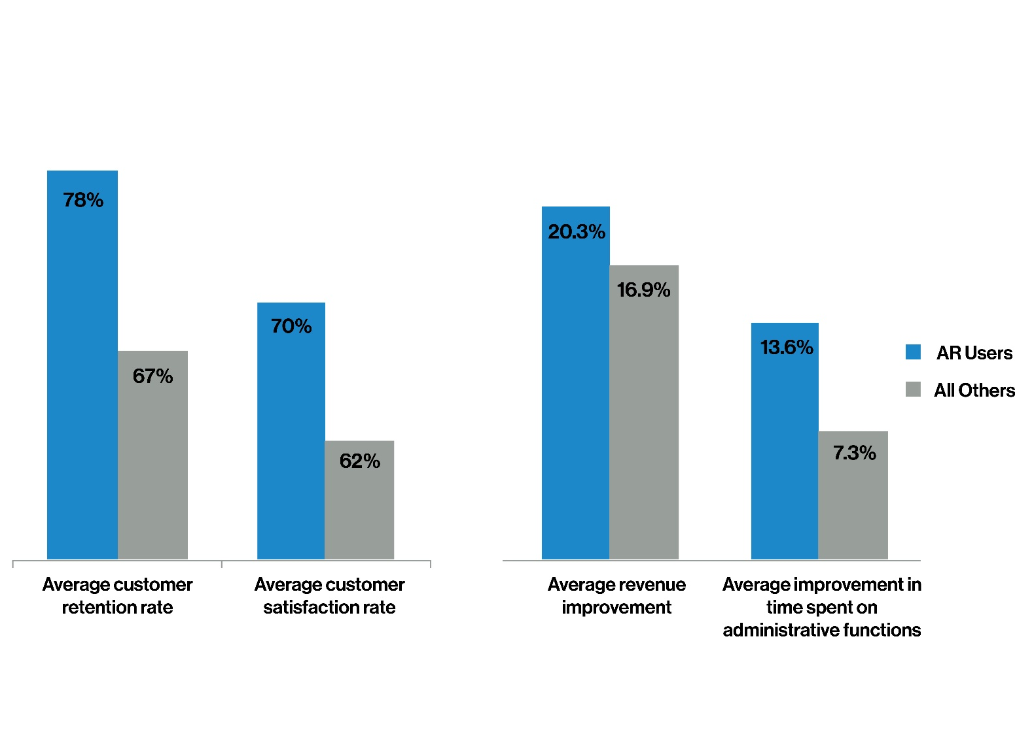
Augmented Reality Impact on Field Service
Notes:
Field Service can become a discipline that can be supercharged with smart use of Augmented Reality

Slide 9
Augmented Reality Maturity Model
Lead
[Best in Class]
No Maturity
Explore
Deploy
Connect & Scale
Immersive technology discussed, no implementation strategy.
Research industry ideas, develop use cases, Explore technology, Build Proof of Concept.
Develop platform strategy, deploy use cases that solve business problems. Establish workflows and KPIs based on experience.
Connect AR platform strategy to boarder enterprise IT ecosystem, deploy across multiple departments with operating workflows, training, measure business value.
Re-invent all processes with AR workflows. ROI is being maximized, KPI driven. Interconnected HW/SW leveraging 5G and edge computing.

Slide 10
Augmented Reality in Your Business
1. Immediate returns
Find out which business areas & which projects will immediately benefit from AR capabilities.
2. Measure outcomes
Understand your KPIs, build insights dashboards, collect data & measure.
3. Thoughtful implementation
Tech platforms, IoT, physical assets, workflow changes, design changes.
4. Optimal mix
Tech – Expert communication, Step-by-step AR tutorials, AR customer self-service.
Success requires focusing on those applications that will return the most value

Slide 11
Contact us to discuss our collaboration partner program and start building your proof of concept now.
Thank you!
For more information, please contact us:
info@radiant.digital
surya.prakash@radiant.digital
Notes:
Radiant specializes in technology solutions, driven by proven methodologies, to help navigate the journey to the digital enterprise.

